Slide 1
CUDA Libraries
Slide credit: Slides adapted from
© David Kirk/NVIDIA and Wen-mei W. Hwu, 2007-2016

Slide 3
3 Ways to Accelerate Applications
Applications
Libraries
Compiler Directives
Programming Languages
Easy to use
Most Performance
Easy to use
Portable code
Most Performance
Most Flexibility

Slide 10
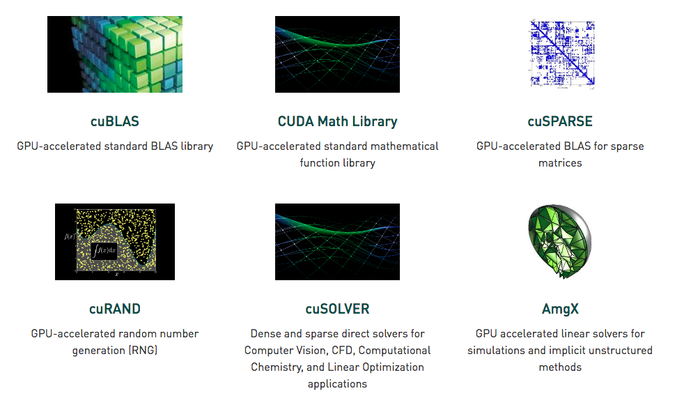
Linear Algebra / Math Libraries
Basic linear algebra
#include “math.h”
Algebraic Multigrid Solver

Slide 11
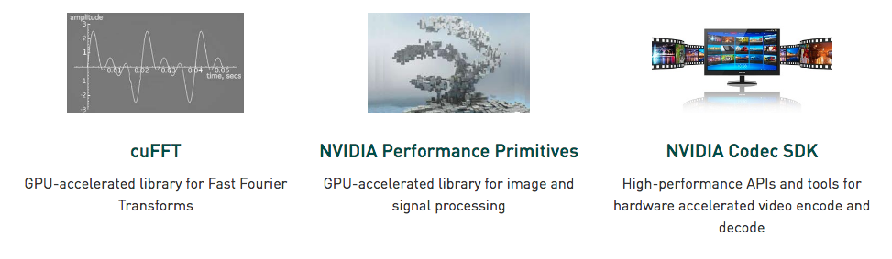
Signal, Image Processing
Color Conversion, Filter, JPEG, Transform

Slide 12
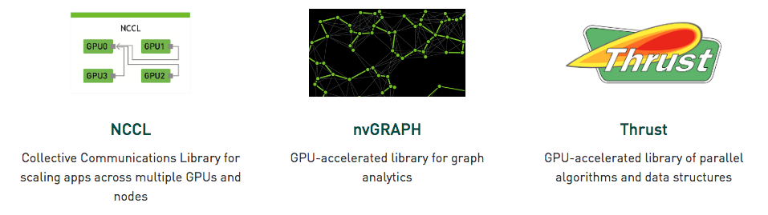
Parallel Algorithms
Page Rank, SSSP, SSWP Graph Traversal primitives
Similar to MPI: Reduce, Broadcast, etc.

Slide 13
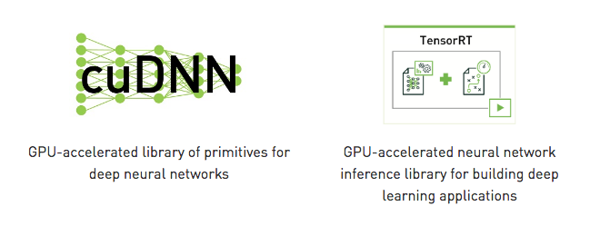

Deep Learning Libraries

Slide 14
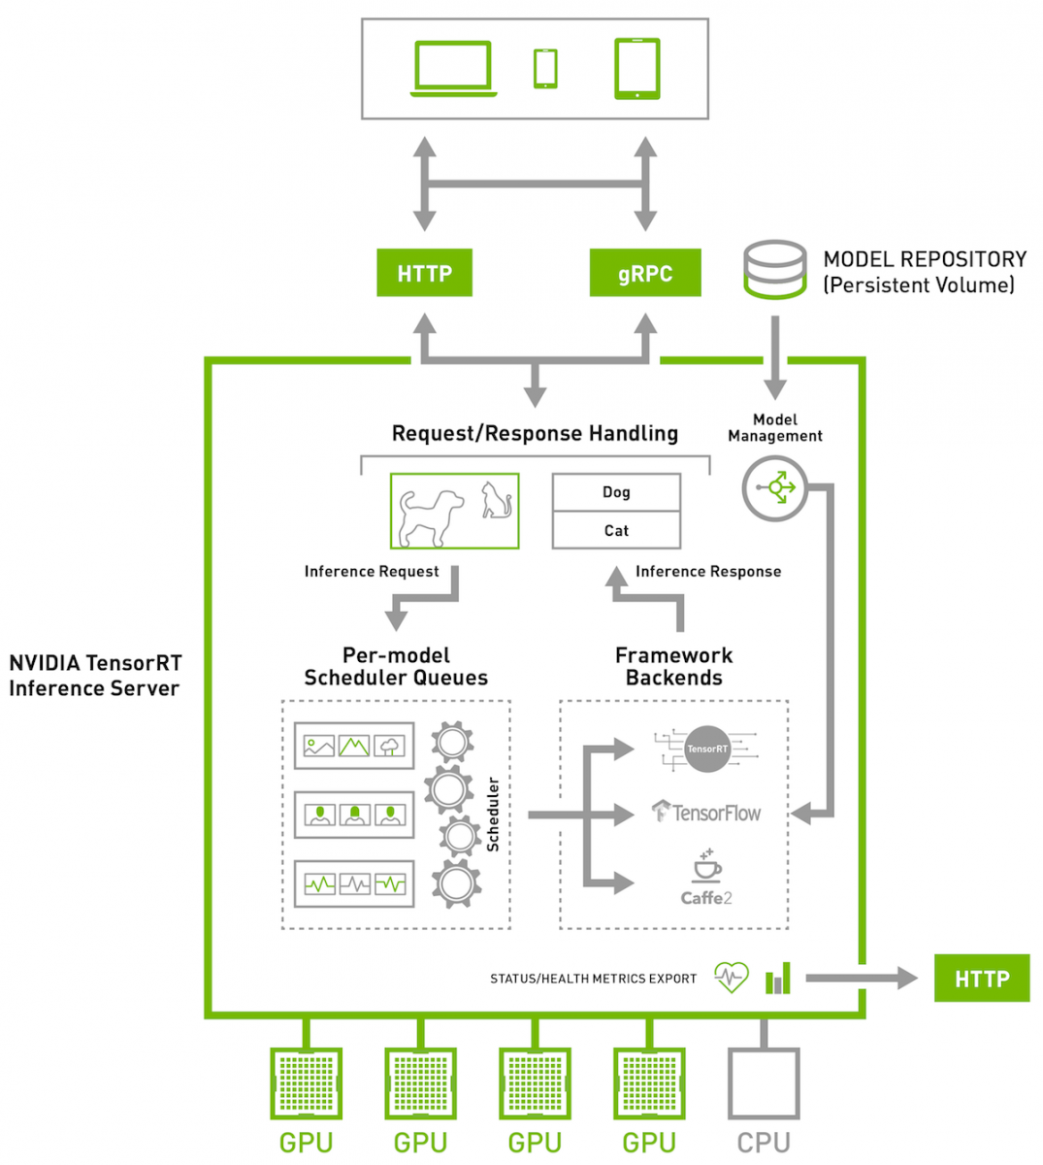
TensorRT

Slide 15
cuDNN
Excellent tutorial here:
http://www.goldsborough.me/cuda/ml/cudnn/c++/2017/10/01/14-37-23-convolutions_with_cudnn/
Basic building blocks for DNNs
Convolution forward and backward, including cross-correlation
Pooling forward and backward
Softmax forward and backward
Neuron activations forward and backward:
Rectified linear (ReLU)
Sigmoid
Hyperbolic tangent (TANH)
Tensor transformation functions
LRN, LCN and batch normalization forward and backward

Slide 16
cuDNN example
For a single convolution (Not a full network)
Create context
Describe Operands (input, output, kernel)
Describe Convolution Kernel
Allocate Memory
Perform Convolution

Slide 17
Create Context
#include <cudnn.h>
int main(int argc, char const *argv[]) { cudnnHandle_t cudnn;
checkCUDNN(cudnnCreate(&cudnn));
}
#define checkCUDNN(expression) \
{ \
cudnnStatus_t status = (expression); \
if (status != CUDNN_STATUS_SUCCESS) { \
std::cerr << "Error on line "<< __LINE__ << ": " \
<< cudnnGetErrorString(status) << std::endl; \
std::exit(EXIT_FAILURE); \
} \
}

Slide 18
Describe Operands
cudnnTensorDescriptor_t input_descriptor; checkCUDNN(cudnnCreateTensorDescriptor(&input_descriptor)); checkCUDNN(cudnnSetTensor4dDescriptor(input_descriptor, /*format=*/CUDNN_TENSOR_NHWC, /*dataType=*/CUDNN_DATA_FLOAT, /*batch_size=*/1, /*channels=*/3, /*image_height=*/image.rows, /*image_width=*/image.cols));
cudnnTensorDescriptor_t output_descriptor; checkCUDNN(cudnnCreateTensorDescriptor(&output_descriptor)); checkCUDNN(cudnnSetTensor4dDescriptor(output_descriptor, /*format=*/CUDNN_TENSOR_NHWC, /*dataType=*/CUDNN_DATA_FLOAT, /*batch_size=*/1, /*channels=*/3, /*image_height=*/image.rows, /*image_width=*/image.cols));
cudnnFilterDescriptor_t kernel_descriptor; (This is the mask) checkCUDNN(cudnnCreateFilterDescriptor(&kernel_descriptor)); checkCUDNN(cudnnSetFilter4dDescriptor(kernel_descriptor, /*dataType=*/CUDNN_DATA_FLOAT, /*format=*/CUDNN_TENSOR_NCHW, /*out_channels=*/3, /*in_channels=*/3, /*kernel_height=*/3, /*kernel_width=*/3));

Slide 19
Describe Convolution
cudnnConvolutionDescriptor_t convolution_descriptor; checkCUDNN(cudnnCreateConvolutionDescriptor(&convolution_descriptor)); checkCUDNN(cudnnSetConvolution2dDescriptor(convolution_descriptor, /*pad_height=*/1, /*pad_width=*/1, /*vertical_stride=*/1, /*horizontal_stride=*/1, /*dilation_height=*/1, /*dilation_width=*/1, /*mode=*/CUDNN_CROSS_CORRELATION, /*computeType=*/CUDNN_DATA_FLOAT));
cudnnConvolutionFwdAlgo_t convolution_algorithm; checkCUDNN( cudnnGetConvolutionForwardAlgorithm(cudnn, input_descriptor, kernel_descriptor, convolution_descriptor, output_descriptor, CUDNN_CONVOLUTION_FWD_PREFER_FASTEST, /*memoryLimitInBytes=*/0, &convolution_algorithm));

Slide 20
Allocate Memory
How much memory do I need?
size_t workspace_bytes = 0; checkCUDNN(cudnnGetConvolutionForwardWorkspaceSize(cudnn, input_descriptor, kernel_descriptor, convolution_descriptor, output_descriptor, convolution_algorithm, &workspace_bytes)); std::cerr << "Workspace size: " << (workspace_bytes / 1048576.0) << "MB" << std::endl;

Slide 21
Allocate Memory
Allocate Workspace
void* d_workspace{nullptr}; cudaMalloc(&d_workspace, workspace_bytes);
Allocate Image
int image_bytes = batch_size * channels * height * width * sizeof(float); float* d_input{nullptr}; cudaMalloc(&d_input, image_bytes); cudaMemcpy(d_input, image.ptr<float>(0), image_bytes, cudaMemcpyHostToDevice); float* d_output{nullptr}; cudaMalloc(&d_output, image_bytes); cudaMemset(d_output, 0, image_bytes);
Allocate Kernel (Mask)
Also just cudaMallocs and cudaMemcpys
float* d_kernel{nullptr}; cudaMalloc(&d_kernel, sizeof(h_kernel)); cudaMemcpy(d_kernel, h_kernel, sizeof(h_kernel), cudaMemcpyHostToDevice);

Slide 22
Perform Convolution
const float alpha = 1, beta = 0; checkCUDNN(cudnnConvolutionForward(cudnn, &alpha, input_descriptor, d_input, kernel_descriptor, d_kernel, convolution_descriptor, convolution_algorithm, d_workspace, workspace_bytes, &beta, output_descriptor, d_output));

Slide 23
Get output and cleanup
float* h_output = new float[image_bytes]; cudaMemcpy(h_output, d_output, image_bytes, cudaMemcpyDeviceToHost); // Do something with h_output ... delete[] h_output; cudaFree(d_kernel); cudaFree(d_input); cudaFree(d_output); cudaFree(d_workspace); cudnnDestroyTensorDescriptor(input_descriptor); cudnnDestroyTensorDescriptor(output_descriptor); cudnnDestroyFilterDescriptor(kernel_descriptor); cudnnDestroyConvolutionDescriptor(convolution_descriptor); cudnnDestroy(cudnn);

